Slide 1
ATM Project using Spring Framwork
Fresher Java K30_ Mock project

Slide 2
Agenda
About team
Validation and Authen
Withdraw
1
2
3
4
5
6
Overview
Check balance
Conclusion

Slide 3




Our team
Lê Văn Phú
PhuLV1
DNU
Phan Xuân Mạnh
ManhPX1
HCMUAF
Trần Anh Quân
QuanTA5
UIT
Mai Văn Hải
HaiMV
HCMUAF

Slide 4
Overview

Slide 5
Validation and authenticate

Slide 6
Check balance
1. Use Case
Name | CheckBalance
Description | This use case allows Customer to check their Balance.
Actor | Customer
Trigger | When Customer click “Check balance” button in MainScreen
Pre-condition | Customer had Validation to ATM.
Post-condition | ATM system display balance of Customer.

Slide 7
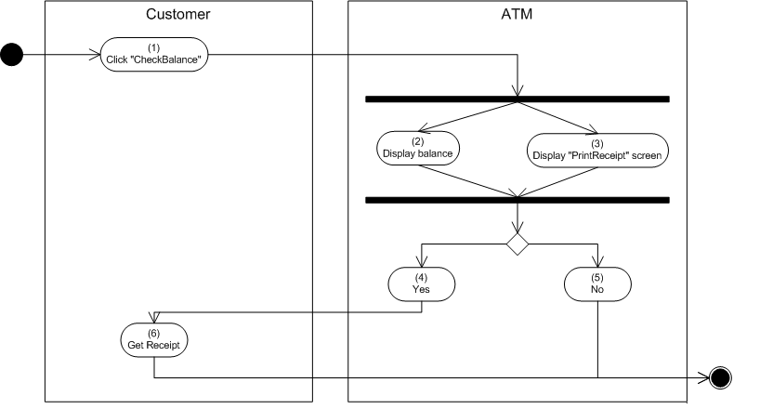
Check balance
2. Activities flow

Slide 8
Check balance
1. Use Case
Name | CheckBalance
Description | This use case allows Customer to check their Balance.
Actor | Customer
Trigger | When Customer click “Check balance” button in MainScreen
Pre-condition | Customer had Validation to ATM.
Post-condition | ATM system display balance of Customer.

Slide 9
Withdraw

Slide 10
Conclusion

